Slide 1




Slide 2

Agenda
Conference Overview
Strategy Map
Bridging the Gap: How Do We Get There From Here
How We Build Bridges
Framework
Initiatives
Planning Teams
Next Steps
Guidance

Slide 3
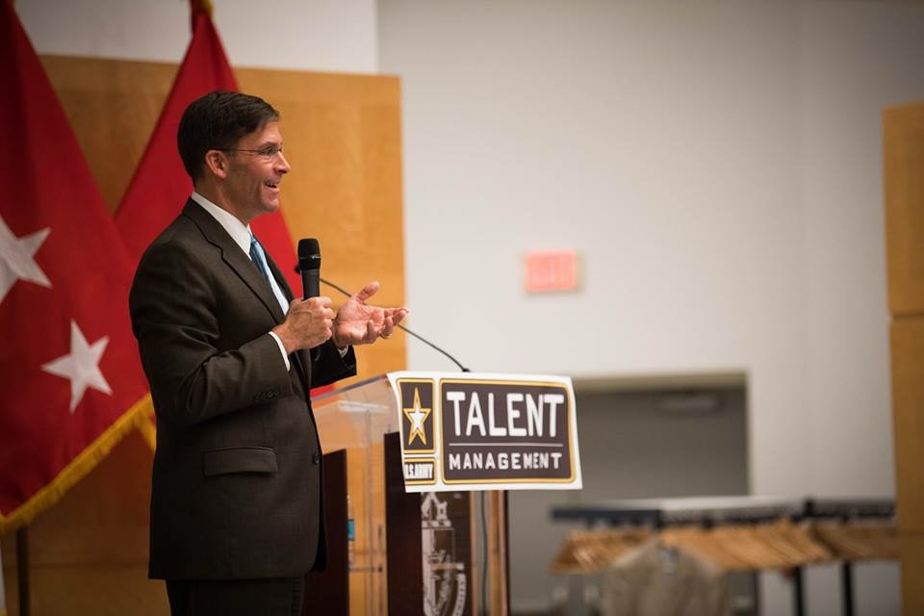
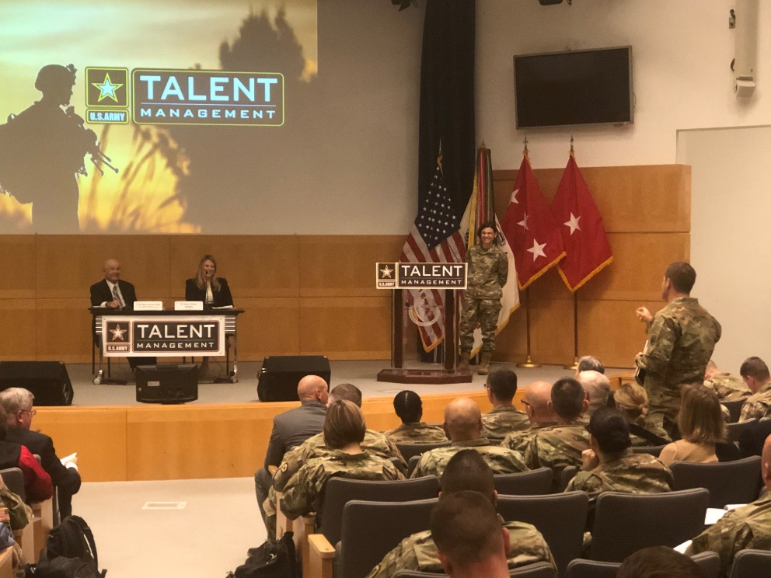
ATMTF Planning Conference
Total Number Of Conference Attendees: 183
Number of Organizations Represented: 108
Including Sister Services, HQDA Staff Sections, Centers of Excellence, AWC, Branch, FA Proponents, and Joint Partners
Hoover Institute
IPPS-A
N1
NGB
Natl'l Cmte on Mil and Pub Sev
O/DUSA
TSG
Univ. of Pennsylvania
USACE
USAF Talent Management Cell
USARC
USASOC
USMA
USMC Talent Management
OCPA
OEMA
OTJAG
OTSG
RAND Corp
RFL
ROTC Cadet Command
SF Regt
SIG
SOCOM
Soldier Support Institute
Strategic Education International
TRADOC
704 MI BDE
75th Innovation Command
AFC
AMC
ARCIC
ARCYBER
ARI
Army Futures Command
Army War College
ArmyU
ARNG
ASA (M&RA)
Asymmetrical Warfare Group
CAC
CAPE
OCAR
CASCOM
CALL
Command General Staff School
COMO
OCSA
Data Acquisition RFL
DBT
FORSCOM
GOMO
HRC
Notes:
-

Slide 4
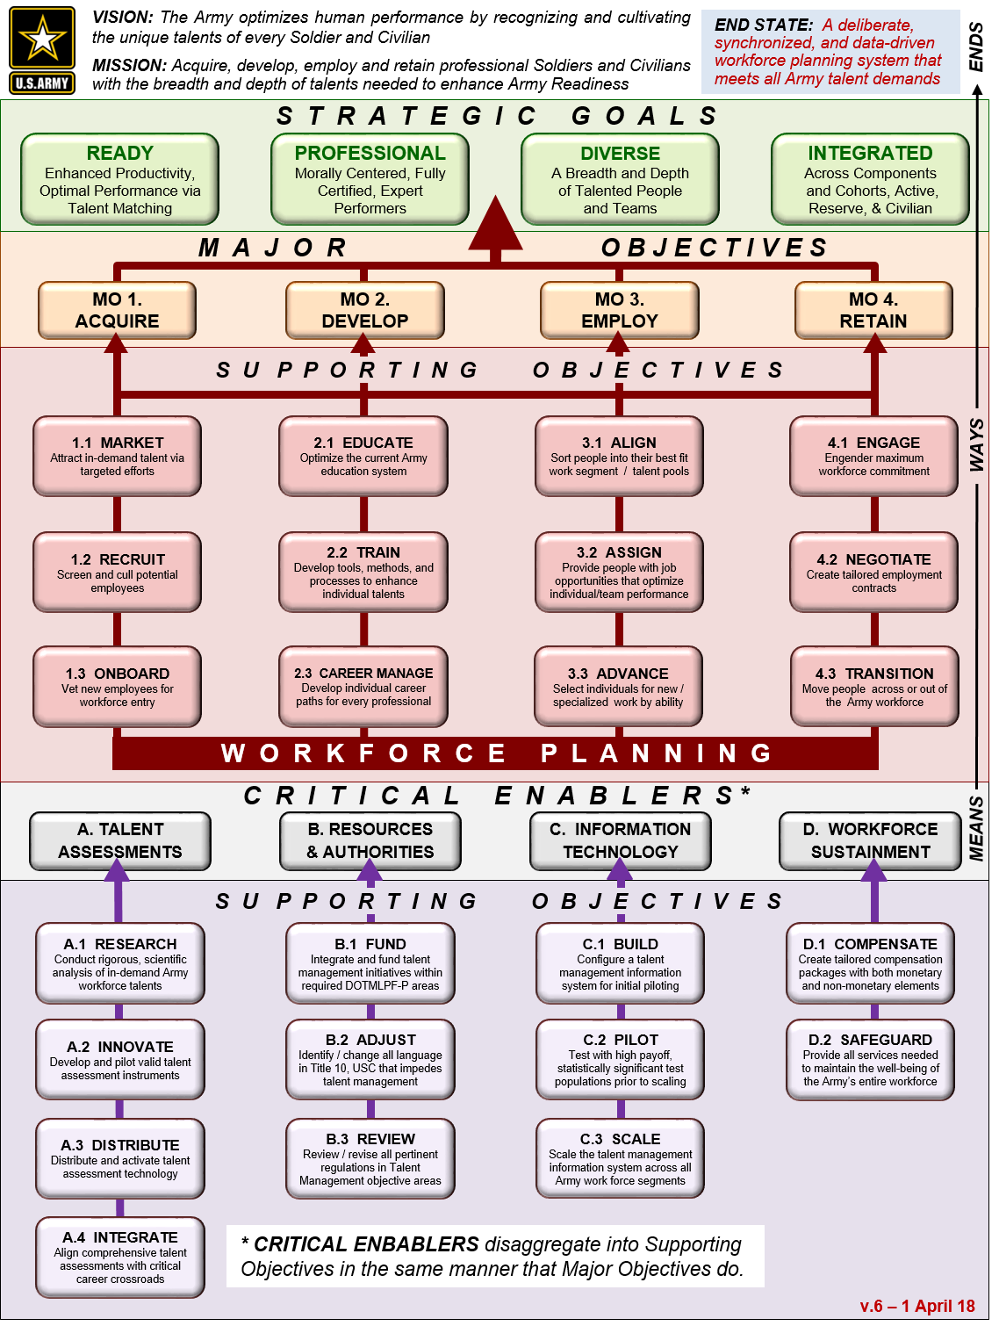
Strategy Map
Problem Statement
How do we move from a data-poor, industrial-age officer distribution system which distributes officers based on manner of performance to an information-age talent management system which matches officers based on talent management principles (knowledge, skills, behaviors, & preferences)?

Slide 5
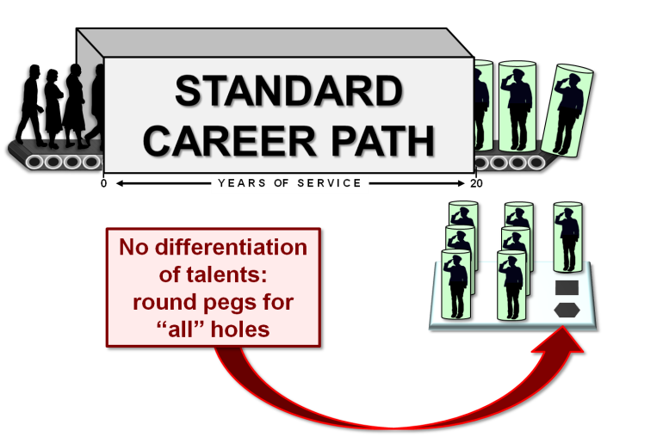


How do we get there from here?
Current System
Initiatives
Future System
Flexible Career Paths Foster Differentiation
F L E X I B L E
1
C A R E
E
R
Lacks Granular level knowledge of Talents
Regulated Market
0
8
Y E A R S OF S E R V I C E
20
TALENTS THAT
MEET DEMAND
2
  Strengths
  Fair
  Scalable
  Predictable
  Developmental
  Gaps
  Directive
  Challenged to adapt to new developments
  Incentivizes standard career paths
  Distributes officers based on performance
  Highly Centralized
  Data poor
  Time-Based
Regulated Marketplace
Able to adapt to disruptive change
Incentivizes non-standard career paths
Matches officers based on talents
Flexible
Decentralized
Leverages technology
Data rich
Predictive
Assessment regimen throughout career
Talent and competency-based
Fair
Scalable
Progressive
Developmental
Assessments
3
Flexible Career Paths

Slide 6
How We Build Bridges – Gap Analysis Framework
STEPS
1
1. Identify Desired Future Performance Outcomes
2
2. Identify Current Performance Outcomes: Collect Data
3
3. Identify Gaps: Measure the Difference Between Current and Desired Performance Outcomes
4
4. Analyze Gaps: Knowledge, Motivation, or Organizational Barriers to Desired Performance Outcomes
5
5. Develop and Test Solutions to Close Gaps (Initiatives: Prototypes and Pilots)
6
6. Evaluate Results: Analyze Outcomes, Repeat Cycle

Slide 7
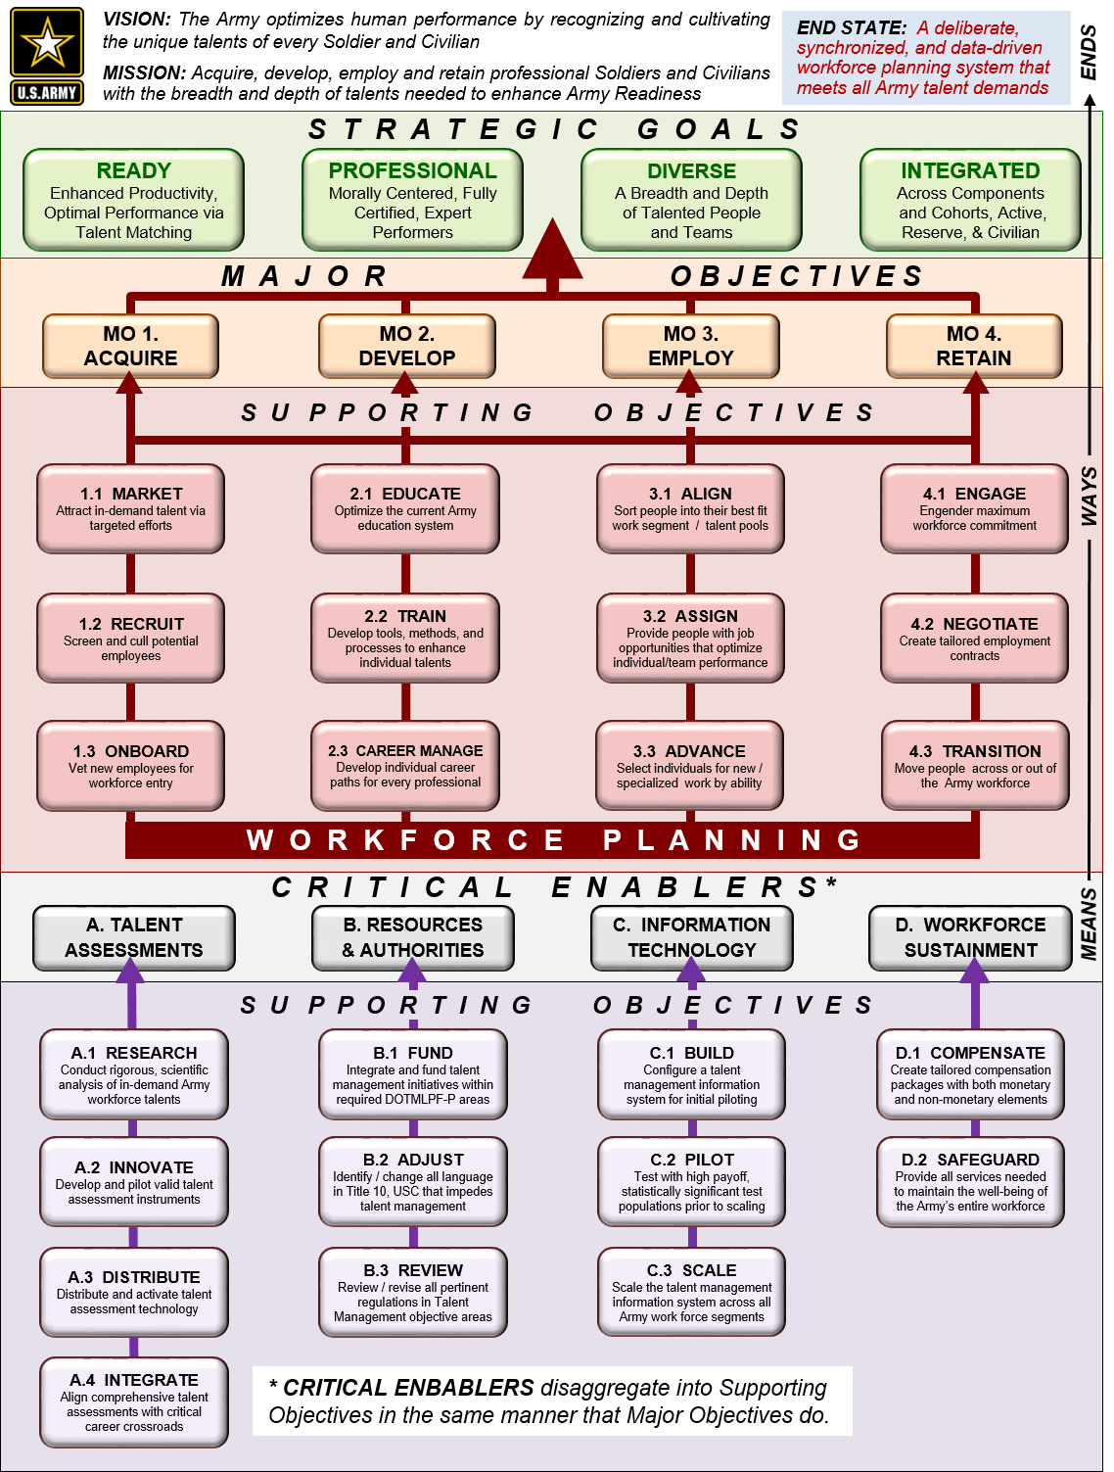
Nesting TM Initiatives within the TM Strategy
1.3.1: Talent-Based Branching
Lead Pillar
1
MO1 – Acquire, 1.3 – Onboard
c
d
Cross Cutting Pillars
a
A – Assessments, A.2 – Innovate
1
b
A – Assessments, A.4 – Integrate
e
c
MO3 – Employ, 3.1 – Align
a
d
MO4 – Retain, 4.1 – Engage
b
e
C – Information Tech, C.1 – Build

Slide 8
MO 1.3 Acquire: Talent Based Branching
MAJOR OBJECTIVE 1 - ACQUIRE TALENT: Identify and recruit the diverse talents required for the current and future force, develop that talent for initial entry into one of the Army’s workforce segments, and set conditions for its optimized employment.
MO 1. ACQUIRE
SUPPORTING OBJECTIVE 1.3 - ONBOARD: Vet new employees with the goal of maximizing their productivity and establishing the terms of their initial employment in one of the Army’s workforce segments.
1.1 MARKET
1.3 ONBOARD
1.2 RECRUIT
T M S T R A T E G Y
I M P L E M E N T A T I O N P L A N
Initiative 1.3.1 – Talent Based Branching (TBB): Legacy assignment mechanisms do not use talent information to align employee talent with job requirements. Using a market based assignment mechanism, TBB will capture and use both supply and demand side talent information to better align cadet talent with Army needs.
1.3.1 Talent Based Branching (TBB)
Task 1.3.1.1 – Gather Talent Information: Create incentives and environments in which branches and cadets can exchange talent information. Collect talent information to inform cadet talent alignment and Army talent supply and demand levels.
1.3.1.1 Gather Talent Information
1.3.1.2 Pilot TBB at USMA
Task 1.3.1.2 – Pilot TBB at USMA:. USMA/DMPM will conduct non-binding pilot of talent based branch and compare outcomes with current practices.

Slide 9
Initiatives
DEVELOP
  Succession Planning (3 tasks)
  Alternate Promotion Concepts (2 tasks)
  Functional Area Branch Detailing ( 1 task)
  Expanded ACS ( 1 task)
  Tailored Officer Development Concept
  Officer Career/Competencies Management Modeling
  EMPLOY
  KSB Feedback Loop
  Marketplace of the Future
  Predictive Analytics
  Unit Engagement Assessment
  Decision Support Tool
  PERMEABILITY
  Single Appointment (1 task)
  IRR Reformation (1 task)
  Reserve Service following Active Federal Retirement
ASSESSMENTS
  Establish Army Assessments Coordination Board
  Talent Assessments for VTIP Pilot
  CCC Assessments Pilot
  SSC Assessments Pilot
  Battalion Commander Assessment Center Pilot
  Assessment Center Operations at CGSC Prototype
  WARRANT
  Senior Warrant Officer Management
  Junior Warrant Officer Development
  Competitive Category Development
Total Number of Initiatives: 23
Number of Initiatives
Being Briefed: 15

Slide 10
Calendar
2QTR19
3QTR19
4QTR19
1QTR20
2QTR20
3QTR20
4QTR20
1QTR20
FA Branch Detailing
Development
Expanded ACS
Alternative Promotion Concept
Succession Planning
KSB Feedback Loop
Employ
Marketplace of the Future
Predicative Analysis
Assessments
Talent Assessment
for VTIP (FA59)
CCC Assessments
Talent Assessment
for VTIP (FA48)
BN CDR Assessment CTR
Permeability
Single Appointment
IRR Reformation
Legislation
Competitive Category Pilot
Warrant Officer
OER Shift
CW5 Panel Pilot
WO1 Pilot

Slide 11
DEVELOP

Slide 12
Develop Initiatives
Initiatives:
  Succession Planning
  Alternate Promotion Concepts
  Functional Area Branch Detailing
  Expanded ACS
  Tailored Officer Development Concept
  Officer Career/Competencies Management Modeling

Slide 13
DEVELOP
Initiative 1:
Succession Planning
Lead Pillar
1
MO2 – Develop, 2.3 – Career Manage
a
h
Cross Cutting Pillars
d
a
MO1 – Acquire, 1.1 – Market
1
e
b
A – Assessments, A.1 – Research
c
B – Resources & Authorities, B.3 – Review
d
MO3 – Employ, 3.2 – Assign
b
f
e
MO3 – Employ, 3.3 – Advance
g
f
C – Info Tech, C.1 – Build
c
g
C – Info Tech, C.2 – Pilot
h
MO4 – Retain, 4.1 – Engage

Slide 14
Initiative 2.3.1.1: Succession Planning
MO 2 DEVELOP
MAJOR OBJECTIVE 2 – DEVELOP: Identify and recruit the diverse talents required for the current and future force, develop that talent for initial entry into one of the Army’s workforce segments, and set conditions for its optimized employment.
SUPPORTING OBJECTIVE 2.3 – CAREER MANAGE: Increase rigor associated with the training, education and credentialing of Army professionals, aligning certification more closely with demonstrated and measurable expertise rather than time in grade, service or position. Professions certify expertise.
2. 1 EDUCATE
2.3 CAREER MANAGE
2.2 TRAIN
T M S T R A T E G Y
I M P L E M E N T A T I O N P L A N
2.3.1 SUCCESSION PLANNING
Initiative 2.3.1 – SUCCESSION PLANNING. A policy or technology-enhanced process that consistently provides the leadership of the Army a choice of specially qualified candidates for critical jobs
Task 2.3.1.1 –
DEVELOP PROTOTYPE.
ATMTF assesses critical general and colonel positions for defined KSB-Ps and develops a prototype succession plan
TIME: 1QTR, FY20
2.3.1.1 DEVELOP PROTOTYPE
2.3.1.2 TABLETOP EXERCISE
2.3.1.3 IMPLEMENT SUCCESSION PLANNING
3
1,2
1. ID Desired Outcomes
2. ID Current Outcomes
3. ID Gaps
4. Analyze Gaps
5. Develop & Test Solutions
6. Evaluate
Results

Slide 15
Initiative 2.3.1.2: Succession Planning
MO 2 DEVELOP
MAJOR OBJECTIVE 2 – DEVELOP: Identify and recruit the diverse talents required for the current and future force, develop that talent for initial entry into one of the Army’s workforce segments, and set conditions for its optimized employment.
SUPPORTING OBJECTIVE 2.3 – CAREER MANAGE: Increase rigor associated with the training, education and credentialing of Army professionals, aligning certification more closely with demonstrated and measurable expertise rather than time in grade, service or position. Professions certify expertise.
2. 1 EDUCATE
2.3 CAREER MANAGE
2.2 TRAIN
T M S T R A T E G Y
I M P L E M E N T A T I O N P L A N
2.3.1 SUCCESSION PLANNING
Initiative 2.3.1 – SUCCESSION PLANNING. A policy or technology-enhanced process that consistently provides the leadership of the Army a choice of specially qualified candidates for critical jobs
Task 2.3.1.2 – TABLETOP EXERCISE. Stakeholders serve as the training audience for a proctored simulation of critical position succession planning
TIME: 3QTR, FY20
2.3.1.1 DEVELOP PROTOTYPE
2.3.1.2 TABLETOP EXERCISE
2.3.1.3 IMPLEMENT SUCCESSION PLANNING
3
1,2
1. ID Desired Outcomes
2. ID Current Outcomes
3. ID Gaps
4. Analyze Gaps
5. Develop & Test Solutions
6. Evaluate
Results

Slide 16
Initiative 2.3.1.3 Succession Planning
MO 2 DEVELOP
MAJOR OBJECTIVE 2 – DEVELOP: Identify and recruit the diverse talents required for the current and future force, develop that talent for initial entry into one of the Army’s workforce segments, and set conditions for its optimized employment.
SUPPORTING OBJECTIVE 2.3 – CAREER MANAGE: Increase rigor associated with the training, education and credentialing of Army professionals, aligning certification more closely with demonstrated and measurable expertise rather than time in grade, service or position. Professions certify expertise.
2. 1 EDUCATE
2.3 CAREER MANAGE
2.2 TRAIN
T M S T R A T E G Y
I M P L E M E N T A T I O N P L A N
2.3.1 SUCCESSION PLANNING
Initiative 2.3.1 – SUCCESSION PLANNING. A policy or technology-enhanced process that consistently provides the leadership of the Army a choice of specially qualified candidates for critical jobs
Task 2.3.1.3 – Implement Succession Planning.
Transfer high-performing LTCs to SLD in order to consolidate succession planning
TIME: 1QTR, FY21
2.3.1.1 DEVELOP PROTOTYPE
2.3.1.2 TABLETOP EXERCISE
2.3.1.3 IMPLEMENT SUCCESSION PLANNING
3
1,2
1. ID Desired Outcomes
2. ID Current Outcomes
3. ID Gaps
4. Analyze Gaps
5. Develop & Test Solutions
6. Evaluate
Results

Slide 17
DEVELOP
Initiative 2: Alt Promotion Concepts
Develop Pillar
1
MO2 – Develop, 2.3 – Career Manage
c
d
Cross Cutting Objectives
a
MO3 – Employ, 3.3 Advance
1
a
b
A – Talent Assessments
b
c
MO3 – Employ, 3.1 Align
d
MO4 – Retain, 4.1 – Engage
e
e
B – Authorities, B.3 Review
Notes:
“Using the GAP Analysis Framework, the Army discovered a new approach to branching that promised to deliver capabilities the legacy system could not. However, true innovation requires both discovery and implementation. Using the Talent Management Strategy Map, we can map the initiative of Talent Based Branching to the strategic goals of Talent Management, making sure it fits within the larger framework and remains integrated with other major initiatives. Talent Management harnesses its effectiveness from its integrated and reinforcing approach to managing talent. Because of this, individual Talent Management initiatives may require new information, players, resources, technology, and thinking. The strategy map provides a way to help coordinate that effort.

Slide 18
Initiative 2.3.1 - Alternate Promotion Concepts
MO 2 DEVELOP
MAJOR OBJECTIVE 2 – DEVELOP: Identify and recruit the diverse talents required for the current and future force, develop that talent for initial entry into one of the Army’s workforce segments, and set conditions for its optimized employment.
SUPPORTING OBJECTIVE 2.3 – CAREER MANAGE: Increase rigor associated with the training, education and credentialing of Army professionals, aligning certification more closely with demonstrated and measurable expertise rather than time in grade, service or position. Professions certify expertise.
2. 1 EDUCATE
2.3 CAREER MANAGE
2.2 TRAIN
T M S T R A T E G Y
I M P L E M E N T A T I O N P L A N
2.3.1 Alt Promo
Initiative 2.3.1 – Problem: The current promotion system uses a board composed of officers from different branches who select individuals for promotion or command based on manner of performance. By enabling branches/FAs to run their own boards and use KSB data information, this initiative will improve the quality of the selection process.
Task 2.3.1.1: Decentralized promotion board. Non-binding promotion process allowing officers to select promotees of the same branch/FA.
Task 2.3.1.2: KSB-P Board. O6 promotion board selecting officers based upon O6 position KSBs and officer preferences.
2.3.1.1 Decentralized
2.3.1.2 KSB-P Board
Resources: Personnel for mock boards; computer modeling
Cost: TBD
Time: 2QTR 20
1, 2
1. ID Desired Outcomes
2. ID Current Outcomes
3. ID Gaps
4. Analyze Gaps
5. Develop & Test Solutions
6. Evaluate
Results

Slide 19
DEVELOP
Functional Area Branch Detailing
Develop Pillar
1
MO3 – Employ, 3.2 – Assign
d
Cross Cutting Objectives
c
1
a
MO3 – Employ, 3.3 Advance
a
b
A – Talent Assessments
b
c
MO2 – Develop, 2.1 Educate
d
MO1 – Acquire, 1.1 market
e
e
B – Authorities, B.3 Review
Notes:
“Using the GAP Analysis Framework, the Army discovered a new approach to branching that promised to deliver capabilities the legacy system could not. However, true innovation requires both discovery and implementation. Using the Talent Management Strategy Map, we can map the initiative of Talent Based Branching to the strategic goals of Talent Management, making sure it fits within the larger framework and remains integrated with other major initiatives. Talent Management harnesses its effectiveness from its integrated and reinforcing approach to managing talent. Because of this, individual Talent Management initiatives may require new information, players, resources, technology, and thinking. The strategy map provides a way to help coordinate that effort.

Slide 20
Initiative 3.2.1 - Functional Area Branch Detailing
MO 3 EMPLOY
MAJOR OBJECTIVE 3 – EMPLOY: Optimize the productivity of each Army professional by aligning their unique talents against organizational talent demands, to the mutual benefit of both the individual and the Army.
SUPPORTING OBJECTIVE 3.2 – ASSIGN: Provide each Army professional with the right job opportunities to unleash his or her talents and thus optimize performance and productivity.
3.1 ALIGN
3.2 ASSIGN
3.3 ADVANCED
T M S T R A T E G Y
I M P L E M E N T A T I O N P L A N
3.2.1 Functional Area Branch Detailing
Initiative 3.2.1 – Functional Area Branch Detailing: Problem: Basic branches need additional lieutenants whereas specific functional areas do not. Talent Based branching allows identification of cadets with FA specific talents. Officers can select for a Functional Area, but are branch detailed to a basic branch until 4-8 years of service when the functional area is able to employ them.
Task 3.2.1 – FA40 Branch Detailing: Enable USMA class of 2020 with Space Ops degrees to select to branch into FA40 Space Ops upon graduation, with a branch detail into basic branch. They will transfer into FA40 after four years of service
3.2.1.1 FA40 Branch Detailing
Resources: None
Cost: None
Time: 2QTR20
1. ID Desired Outcomes
2. ID Current Outcomes
3. ID Gaps
4. Analyze Gaps
5. Develop & Test Solutions
6. Evaluate
Results

Slide 21
DEVELOP
Initiative 4:
Expanded ACS
Develop Pillar
1
MO2 – Develop, 2.1 – Educate
e
1
Cross Cutting Objectives
d
c
a
MO3 – Employ, 3.3 Advance
a
b
D – Workforce Sustainment – D.2 Safeguard
c
MO2 – Develop, 2.2 Train
b
d
MO1 – Acquire, 1.2 Recruit
e
MO1 – Acquire, 1.1 Market
Notes:
“Using the GAP Analysis Framework, the Army discovered a new approach to branching that promised to deliver capabilities the legacy system could not. However, true innovation requires both discovery and implementation. Using the Talent Management Strategy Map, we can map the initiative of Talent Based Branching to the strategic goals of Talent Management, making sure it fits within the larger framework and remains integrated with other major initiatives. Talent Management harnesses its effectiveness from its integrated and reinforcing approach to managing talent. Because of this, individual Talent Management initiatives may require new information, players, resources, technology, and thinking. The strategy map provides a way to help coordinate that effort.

Slide 22
Initiative 2.1 Expanded ACS
MO 2 DEVELOP
MAJOR OBJECTIVE 2 – DEVELOP: Identify and recruit the diverse talents required for the current and future force, develop that talent for initial entry into one of the Army’s workforce segments, and set conditions for its optimized employment.
2.3 CERTIFY
SUPPORTING OBJECTIVE 2.1 - EDUCATE: Raise awareness of Army employment opportunities and attract in-demand talent, targeting efforts against specific talent pools in the American labor market where that talent is most likely to reside.
2. 2 TRAIN
2.1 EDUCATE
T M S T R A T E G Y
I M P L E M E N T A T I O N P L A N
2.1.1 Expanded ACS
Initiative 2.1.1: Problem-Officers currently compete for ACS after command as O3s. Basic branch officers do not have time to compete due to long command queues. Expanding current ACS opportunities to post-KD majors to compete for schooling increases the opportunities officers have to attend graduate school.
Task 2.1.1.1 – Expand ACS to KD MAJ In 2019, three ACS programs will expand their eligibility window to encompass KD MAJs. The revised eligibility window is KD CPT – KD MAJ. The programs are:
Wright Fellowship (TRADOC)
VCU Supply Chain Management (CASCOM)
Performance Based Graduate School Incentive (PBGSIP) (HRC)
2.1.1.1 Expand ACS to KD MAJ
Resources: None
Cost: TBD
Time: 1QTR 20
1. ID Desired Outcomes
2. ID Current Outcomes
3. ID Gaps
4. Analyze Gaps
5. Develop & Test Solutions
6 Evaluate
Results

Slide 23
EMPLOY

Slide 24
Employ Initiatives
Initiative:
  KSB Feedback Loop
  Marketplace of the Future
  Predictive Analytics
  Unit Engagement Assessment
  Decision Support Tool

Slide 25
EMPLOY
Initiative 1: KSB Feedback Loop
Lead Pillar
1
MO3 – Employ, 3.1 – Align
2
MO3 – Employ, 3.2 – Assign
1
e
Cross Cutting Pillars
c
2
a
C – Information Technology
b
b
MO2 – Develop, 2.3 Career Manage
a
c
MO2 – Develop, 2.2 Train
d
d
A – Talent Assessments, A.1 - Research
e
MO4 – Retain, 4.1 Engage
Notes:
“Using the GAP Analysis Framework, the Army discovered a new approach to branching that promised to deliver capabilities the legacy system could not. However, true innovation requires both discovery and implementation. Using the Talent Management Strategy Map, we can map the initiative of Talent Based Branching to the strategic goals of Talent Management, making sure it fits within the larger framework and remains integrated with other major initiatives. Talent Management harnesses its effectiveness from its integrated and reinforcing approach to managing talent. Because of this, individual Talent Management initiatives may require new information, players, resources, technology, and thinking. The strategy map provides a way to help coordinate that effort.

Slide 26
Initiative 3.2.1: KSB Feedback Loop FEB-AUG ‘19 Pilot
MO 3. EMPLOY
MAJOR OBJECTIVE 3 – EMPLOY TALENT: Identify and recruit the diverse talents required for the current and future force, develop that talent for initial entry into one of the Army’s workforce segments, and set conditions for its optimized employment.
3.1 ALIGN
3.2 ASSIGN
3.3 ADVANCE
SUPPORTING OBJECTIVE 3.2 - ASSIGN: Vet new employees with the goal of maximizing their productivity and establishing the terms of their initial employment in one of the Army’s workforce segments.
T M S T R A T E G Y
I M P L E M E N T A T I O N P L A N
3.2.1 KSB Feedback Loop
Initiative 3.1.1 – KSB Feedback Loop. Identify individual and position level KSBs to enable talent matches. Inserting initial set of KSBs for use by Officers and Units during the pre-market information input.
Task 3.2.1.1 – Gather initial KSBs, FEB-MAR‘19 Pilot: Gather usage data from initial KSBs from units and officers
Task 3.2.1.2 – Refine initial KSB set, MAR-AUG‘19 Pilot: Analyze usage data from Task 3.1.1.1 then analyze for refinement to support more accurate KSB information
Resources: N/A
Cost: N/A
Time: FEB-AUG 2019
3.2.1.1 Gather initial KSBs
FEB-MAR19 Pilot
3.2.1.2 Refine initial KSB set
MAR-AUG19 Pilot
1. ID Desired Outcomes
2. ID Current Outcomes
3. ID Gaps
4. Analyze
Gaps
5. Develop & Test Solutions
6. Evaluate
Results

Slide 27
EMPLOY
Initiative 2: Marketplace of the Future
Lead Pillar
1
MO3 – Employ, 3.1 – Align
2
MO3 – Employ, 3.2 – Assign
e
1
f
3
MO3 – Employ, 3.3 – Advance
Cross Cutting Pillars
c
2
a
C – Information Technology
b
3
b
MO2 – Develop, 2.3 Career Manage
c
MO2 – Develop, 2.2 Train
a
d
A – Talent Assessments, A.1 - Research
d
e
MO1 – Acquire, 1.1 Market
f
MO4 – Retain, 4.1 Engage
Notes:
“Using the GAP Analysis Framework, the Army discovered a new approach to branching that promised to deliver capabilities the legacy system could not. However, true innovation requires both discovery and implementation. Using the Talent Management Strategy Map, we can map the initiative of Talent Based Branching to the strategic goals of Talent Management, making sure it fits within the larger framework and remains integrated with other major initiatives. Talent Management harnesses its effectiveness from its integrated and reinforcing approach to managing talent. Because of this, individual Talent Management initiatives may require new information, players, resources, technology, and thinking. The strategy map provides a way to help coordinate that effort.

Slide 28
Initiative 3.2.2: Marketplace of the Future, JAN-NOV‘19 Pilot
MO 3. EMPLOY
MAJOR OBJECTIVE 3 – EMPLOY TALENT: Identify and recruit the diverse talents required for the current and future force, develop that talent for initial entry into one of the Army’s workforce segments, and set conditions for its optimized employment.
SUPPORTING OBJECTIVE 3.2 - ASSIGN: Vet new employees with the goal of maximizing their productivity and establishing the terms of their initial employment in one of the Army’s workforce segments.
3.1 ALIGN
3.2 ASSIGN
3.3 ADVANCE
T M S T R A T E G Y
I M P L E M E N T A T I O N P L A N
Initiative 3.2.2 – Marketplace of the Future. Expand existing AIM-2 capabilities to inform the marketplace of the future. The logical subsumption of AIM-2 into IPPS-A
3.2.2 Marketplace of the Future
Task 3.2.2.1 – Integrate COMO, SJA, CHP, and CSL into AIM-2 Marketplace, JAN-NOV‘19 Pilot: Bring all OPMD managed officers into the Talent Marketplace
Task 3.2.2.2 – Improve design, interface, user-experience, and functionality of AIM-2 in support of Talent Management, JAN-NOV‘19 Pilot: Build existing AIM-2 Regulated Market to reflect desired Marketplace of the Future.
3.2.2.1 Integrate COMO, SJA, CHP
JAN-NOV19 Pilot
3.2.2.2 Improve Design, Interface, Functionality
JAN-NOV19 Pilot
3.2.2.3 Refine and coordinate requirements
JAN-AUG19 Pilot
Task 3.2.2.3 – Refine and coordinate the requirements of the Future Marketplace, JAN-AUG‘19 Pilot: IPPS-A subsumes Marketplace of the Future
COST: $6.5M
RESOURCES: Man-hours
1. ID Desired Outcomes
2. ID Current Outcomes
3. ID Gaps
4. Analyze
Gaps
5. Develop & Test Solutions
6. Evaluate
Results

Slide 29
EMPLOY
Initiative 3:
Predictive Analytics
Lead Pillar
1
MO3 – Employ, 3.1 – Align
2
MO3 – Employ, 3.2 – Assign
1
d
3
MO3 – Employ, 3.3 – Advance
Cross Cutting Pillars
2
a
C – Information Technology
b
3
b
MO2 – Develop, 2.3 Career Manage
a
c
A – Talent Assessments, A.1 - Research
c
d
MO4 – Retain, 4.1 Engage
Notes:
“Using the GAP Analysis Framework, the Army discovered a new approach to branching that promised to deliver capabilities the legacy system could not. However, true innovation requires both discovery and implementation. Using the Talent Management Strategy Map, we can map the initiative of Talent Based Branching to the strategic goals of Talent Management, making sure it fits within the larger framework and remains integrated with other major initiatives. Talent Management harnesses its effectiveness from its integrated and reinforcing approach to managing talent. Because of this, individual Talent Management initiatives may require new information, players, resources, technology, and thinking. The strategy map provides a way to help coordinate that effort.

Slide 30
Initiative 3.2.3: Predictive Analytics, JAN-JUL‘19 Pilot
MO 3. EMPLOY
MAJOR OBJECTIVE 3 – EMPLOY TALENT: Identify and recruit the diverse talents required for the current and future force, develop that talent for initial entry into one of the Army’s workforce segments, and set conditions for its optimized employment.
3.1 ALIGN
3.2 ASSIGN
3.3 ADVANCE
SUPPORTING OBJECTIVE 3.2 - ASSIGN: Vet new employees with the goal of maximizing their productivity and establishing the terms of their initial employment in one of the Army’s workforce segments.
T M S T R A T E G Y
I M P L E M E N T A T I O N P L A N
3.2.3 Predictive Analytics
Initiative 3.2.3 – Predictive Analytics. Leverage findings from advanced research and best-practices. Enhances characterization and assessment of positions (billets) and human capital.
Task 3.2.3.1 – Develop Minimum Viable Product (MVP) integrating enhanced data sources, and advanced algorithms to support talent management, JAN-JUL‘19 Pilot: Embed progressive predictive analysis tool.
COST: $1.6M
3.2.2.1 Develop MVP, JAN-NOV19 Pilot
1. ID Desired Outcomes
2. ID Current Outcomes
3. ID Gaps
4. Analyze
Gaps
5. Develop & Test Solutions
6. Evaluate
Results

Slide 31
PERMEABILITY

Slide 32
Permeability Initiatives
Initiatives:
  Single Appointment
  IRR Reformation
  Reserve Service following Active Federal Retirement

Slide 33
Permeability
Initiative 1:
Single Appointment
Critical Enabler
1
Resources & Authorities, B.2 – Adjust
Cross Cutting Pillars
c
a
MO1 – Acquire, 1.3 – Onboard
b
MO2 – Develop, 2.3 Career Manage
c
MO3 – Employ, 3.1 Align
a
b
d
d
MO4 - Retain, 4.3 – Transition
Initiative 2:
IRR Reformation
Lead Pillar
1
MO4 - Retain, 4.3 – Transition
Cross Cutting Pillars
1
a
MO1 – Acquire, 1.3 – Onboard
b
MO2 – Develop, 2.3 Career Manage
c
MO3 – Employ, 3.1 Align
d
MO4 - Retain, 4.3 – Transition

Slide 34
Initiative B.2.1: SINGLE APPOINTMENT
CRITICAL ENABLER B. – RESOURCES AND AUTHORITIES: Identify the costs, as well as the legislative and regulatory impediments to all talent management efforts. Seek both program funding and the rewrite of laws, statutes, regulations and policies as necessary or appropriate.
B. RESOURCES & AUTHORITIES
SUPPORTING OBJECTIVE B.2 - ADJUST: Identify and seek language adjustments to specific laws or statutes in Title 10, USC that impede talent management. Draft replacement language as appropriate to codify talent management best practices.
B.1 FUND
B.2 ADJUST
B.3 REVIEW
T M S T R A T E G Y
I M P L E M E N T A T I O N P L A N
Initiative B.2.1 – SINGLE APPOINTMENT:
  Title X requirements for the original appointment of officers serve as a constraint to the permeability needs of the Army. These requirements further impact readiness, talent management decision cycles, and Soldier career flexibility. New officer accessions and officers transitioning between the active and reserve component receive a new original appointment to either the Regular Army or the Reserve of the Army. FY20 NDAA
B.2.1 SINGLE APPOINTMENT
Task B.2.1.1 – SUBMIT LEGISLATIVE PROPOSAL:
B.2.1.2 TITLE
B.2.1.1 SUBMIT LEGISLATIVE PROPOSAL
  Submit a legislative proposal directing new officer accessions receive a single original appointment to the Army of the United States and require no further appointment when transitioning between components. OCT’19
1. ID Desired Outcomes
2. ID Current Outcomes
3. ID Gaps
4. Analyze Gaps
5 Develop & Test Solutions
6. Evaluate
Results

Slide 35
Initiative 4.3.2.1: IRR REFORMATION
MO 4
RETAIN
MAJOR OBJECTIVE 4 – RETAIN: Identify individuals with in-demand talents and engage them with an integrated mix of incentives and opportunities as part of a tailored labor contract. This includes migration across Army workforce segments if called for (permeability). Simultaneously, provide transition benefits and services to those individuals whose talents are no longer in demand within the Army workforce.
4. 1 ENGAGE
4.3 TRANSITION
4. 2 NEGOTIATE
SUPPORTING OBJECTIVE 4.3 – TRANSITION: Engender maximum workforce commitment and productivity in support of all Army missions through mentorship, career counseling and individual career planning.
T M S T R A T E G Y
I M P L E M E N T A T I O N P L A N
4.3.2. IRR REFORMATION
Initiative 4.3.2 – IRR REFORMATION:
  The current Cold War construct of the IRR does not provide a viable ready pool of talent. The IRR as designed is not optimized to employ talent for operations, due to our current military service obligation policies
  .
Task 4.3.2.1 – Army Strategic Augmentation Force (ASAF)
4.3.2.1 ASAF Development
4.3.2.2 Military Service Obligation Modernization
  Modernize current Military Service Obligations to develop an Army Strategic Augmentation Force (ASAF) that retains ready and available talent engaged in our Nation’s defense.
1. ID Desired Outcomes
2. ID Current Outcomes
3. ID Gaps
4. Analyze Gaps
5. Develop & Test Solutions
6. Evaluate
Results
35

Slide 36
Initiative 4.3.2: IRR REFORMATION
MO 4
RETAIN
MAJOR OBJECTIVE 4 – RETAIN: Identify individuals with in-demand talents and engage them with an integrated mix of incentives and opportunities as part of a tailored labor contract. This includes migration across Army workforce segments if called for (permeability). Simultaneously, provide transition benefits and services to those individuals whose talents are no longer in demand within the Army workforce.
4. 1 ENGAGE
4.3 TRANSITION
4. 2 NEGOTIATE
SUPPORTING OBJECTIVE 4.3 – TRANSITION: Engender maximum workforce commitment and productivity in support of all Army missions through mentorship, career counseling and individual career planning.
T M S T R A T E G Y
I M P L E M E N T A T I O N P L A N
4.3.2. IRR REFORMATION
Initiative 4.3.2 – IRR REFORMATION:
  The IRR as designed is not optimized to employ talent for operations, due to our current military service obligation policies, lack of data structure and poor accountability mechanisms.
  .
4.3.2.1 ASAF Development
Task 4.3.2.2 – Military Service Obligation Modernization
4.3.2.2 Military Service Obligation Modernization
  Eliminate the mandatory nature of the IRR by requiring fulfillment of the Military Service Obligation on either Active duty, the Selective Reserve or a combination thereof.
  .
1. ID Desired Outcomes
2. ID Current Outcomes
3. ID Gaps
4. Analyze Gaps
5. Develop & Test Solutions
6. Evaluate
Results
36

Slide 37
ASSESSMENTS

Slide 38
Assessment Initiatives
Initiatives:
  Establish Army Assessments Coordination Board
  Talent Assessments for VTIP Pilot
  CCC Assessments Pilot
  SSC Assessments Pilot
  Battalion Commander Assessment Center Pilot
  Assessment Center Operations at CGSC Prototype

Slide 39
ASSESSMENTS
Initiative 2 –
Talent Assessment for VTIP
Critical Enabler
d
1
A. Talent Assessments
c
a
Cross Cutting Objectives
a
MO3 – Employ, 3.1 Align
b
b
MO2 – Develop, 2.3 Career Manage
1
Notes:
“Using the GAP Analysis Framework, the Army discovered a new approach to branching that promised to deliver capabilities the legacy system could not. However, true innovation requires both discovery and implementation. Using the Talent Management Strategy Map, we can map the initiative of Talent Based Branching to the strategic goals of Talent Management, making sure it fits within the larger framework and remains integrated with other major initiatives. Talent Management harnesses its effectiveness from its integrated and reinforcing approach to managing talent. Because of this, individual Talent Management initiatives may require new information, players, resources, technology, and thinking. The strategy map provides a way to help coordinate that effort.

Slide 40
Initiative A.1.1: TALENT ASSESSMENT FOR VTIP
CRITICAL ENABLER A. – ASSESSMENTS: Acquire and employ a talent management information system that provides the Army with accurate, granular information on both the talent supply resident in its entire workforce and the talent requirements of its organizations, enabling alignment of both.
A. ASSESSMENTS
SUPPORTING OBJECTIVE A.1 - RESEARCH: Conduct rigorous and scientifically informed analysis of the talents required in the Army’s workforce, providing an institutional bridge between the professional expertise of the Army and the scientific expertise of psychometric and assessment professionals.
A.2 INNOVATE
A.1 RESEARCH
A.3 BUILD
T M S T R A T E G Y
I M P L E M E N T A T I O N P L A N
Initiative A.1.1 – Talent Assessment for VTIP Incorporate talent assessment to optimize officer-functional area alignment
A.1.1 Talent Assessment for VTIP
Task A.1.1.1 – ASSESSMENT PILOT TASKS. ID KSB requirements for FAs; utilize existing or develop new validated instruments; conduct non-binding, then binding pilots; make recommendation for implementation.
Cost: $300K/FY per functional area
Time: 2QTR 19 – FA59 implement; 2QTR 20 – FA 48 prototype
A.1.1.2 TITLE
A.1.1.1 Assessment Pilot Tasks
1. ID Desired Outcomes
2. ID Current Outcomes
48
59
3. ID Gaps
4. Analyze
Gaps
5. Develop & Test Solutions
6. Evaluate
Results

Slide 41
ASSESSMENTS
Initiative 3-
CCC Assessments
Critical Enabler
d
1
A. Talent Assessments
c
a
Cross Cutting Objectives
a
MO3 – Employ, 3.1 Align
b
b
MO2 – Develop, 2.3 Career Manage
1
Notes:
“Using the GAP Analysis Framework, the Army discovered a new approach to branching that promised to deliver capabilities the legacy system could not. However, true innovation requires both discovery and implementation. Using the Talent Management Strategy Map, we can map the initiative of Talent Based Branching to the strategic goals of Talent Management, making sure it fits within the larger framework and remains integrated with other major initiatives. Talent Management harnesses its effectiveness from its integrated and reinforcing approach to managing talent. Because of this, individual Talent Management initiatives may require new information, players, resources, technology, and thinking. The strategy map provides a way to help coordinate that effort.

Slide 42
Initiative A.2.1: CCC ASSESSMENTS
CRITICAL ENABLER A. – ASSESSMENTS: Acquire and employ a talent management information system that provides the Army with accurate, granular information on both the talent supply resident in its entire workforce and the talent requirements of its organizations, enabling alignment of both.
A. ASSESSMENTS
SUPPORTING OBJECTIVE A.2 - INNOVATE: Develop and pilot valid assessment instruments suited to the task of measuring the Army’s unique talent requirements in conjunction with industry leaders and assessment best practices.
A.1 RESEARCH
A.2 INNOVATE
A.3 BUILD
T M S T R A T E G Y
I M P L E M E N T A T I O N P L A N
Initiative A.2.1 – CCC Assessments Pilot CCC diagnostic cognitive and non-cognitive assessments to inform officers of their KSBs for self-development and career planning
A.2.1 CCC Assessments
Task A.2.1.1 – Assessment Pilot Tasks. ID KSB requirements across branches; utilize existing or develop new cognitive and non-cognitive instruments; conduct assessments; analyze data and provide feedback.
Cost: $1.7M per FY (assessments/coaching; GRE)
Time: 3QTR 19
A.2.1.2 TITLE
A.2.1.1 Assessment Pilot Tasks
1. ID Desired Outcomes
2. ID Current Outcomes
3. ID Gaps
4. Analyze
Gaps
5. Develop & Test Solutions
6. Evaluate
Results

Slide 43
ASSESSMENTS
Initiative 5 –
BN CDR Assessment Center
Critical Enabler
d
1
A. Talent Assessments
Cross Cutting Objectives
a
a
MO3 – Employ, 3.2 Assign
c
b
b
MO3 – Employ, 3.3 Advance
c
MO2 – Develop, 2.3 Career Manage
1
Notes:
“Using the GAP Analysis Framework, the Army discovered a new approach to branching that promised to deliver capabilities the legacy system could not. However, true innovation requires both discovery and implementation. Using the Talent Management Strategy Map, we can map the initiative of Talent Based Branching to the strategic goals of Talent Management, making sure it fits within the larger framework and remains integrated with other major initiatives. Talent Management harnesses its effectiveness from its integrated and reinforcing approach to managing talent. Because of this, individual Talent Management initiatives may require new information, players, resources, technology, and thinking. The strategy map provides a way to help coordinate that effort.

Slide 44
Initiative A.3.1: BN CDR ASSESSMENT CENTER
CRITICAL ENABLER A. – ASSESSMENTS: Acquire and employ a talent management information system that provides the Army with accurate, granular information on both the talent supply resident in its entire workforce and the talent requirements of its organizations, enabling alignment of both.
A. ASSESSMENTS
SUPPORTING OBJECTIVE A.3 - BUILD: Distribute and activate talent assessment technology to create the talent assessment infrastructure suitable for the operational needs of the Army.
A.1 RESEARCH
A.3 BUILD
A.2 INNOVATE
T M S T R A T E G Y
I M P L E M E N T A T I O N P L A N
Initiative A.3.1 – BN CDR Assessment Center. Inform future improvements to CSL BN CMD process by adding objectivity and providing another way for officers from alternate list to compete a number of commands
A.3.1 BN CDR Assessment Center
Task A.3.1.1 – Assessment Prototype Tasks. ID KSB requirements for battalion command and design assessment center operation; prototype assessment center (non-binding) w/ CSL alternate list; compare results of assessment to CSL alternate list to determine value of comprehensive assessment compared to CSL board.
Cost: $200k for initial prototype
Time: 3QTR 19
A.3.1.2 TITLE
A.3.1.1 Assessment Prototype Tasks
1. ID Desired Outcomes
2. ID Current Outcomes
3. ID Gaps
4. Analyze
Gaps
5. Develop & Test Solutions
6. Evaluate
Results

Slide 45
Army Warrant Officer Cohort Modernization
VCSA
Back Brief
(11 JAN 2019)
As of: 10 JAN 19 POC: CW5 Douglas Englen Version 1

Slide 46
Army Warrant Officers
What is a WO? (Specified DA PAM 600-3):
The technical expert, combat leader, trainer, and advisor. Through progressive levels of expertise in assignments, training, and education, the warrant officer administers, manages, maintains, operates, and integrates Army systems and equipment across unified land operations. Warrant officers are innovative integrators of emerging technologies, dynamic teachers, confident warfighters, and developers of specialized teams of Soldiers.
Army Requirement (Unstated):
Technical expertise is necessary to maintain a comparative advantage in todays complex, emerging technical and operational environment. Officer and Non-Commissioned Officer career models generally do not support a deepened technical expertise due to rapid acceleration in leadership. Functional Area Officer career paths narrowly span a technical specialty or skill other than an arm, Service, or branch that usually requires unique education, training, and experience. The Army Warrant Officer fulfills multiple expertise requirements to fill the technical requirements gaps.
Notes:
Executed philosophy places seniority over merit and perpetuates an egalitarian spirit
Proposed philosophy is focused on merit

Slide 47
Army Warrant Officers
Executed Philosophy (Unstated):
Warrant Officer Management Act (WOMA 1991) is the statutory framework for the strength, promotion and separation of regular and reserve warrant officers. WOMA 1991 indoctrinated the Commissioned Officer management process, a “one-size-fits-all” industrial approach.
Proposed New Philosophy:
A comprehensive and tailored Warrant Officer personnel management system to provide the Secretary of the Army greater flexibility to increase lethality, readiness, and talent within the warrant officer cohort.
Notes:
Executed philosophy places seniority over merit and perpetuates an egalitarian spirit
Proposed philosophy is focused on merit

Slide 48
AMERICA’S ARMY:
UNCLASSIFIED
Army Warrant Officer Initiatives
Warrant Officer Management Act (WOMA) of 1991 created an industrial based management system. Modernizing creates a tailored management system.
  Lines of Effort:
      FY19 NDAA DOPMA examples for WOMA modernization
      Senior Warrant Officer Management – Not defined since the 1st CW5 promotion
      Junior Warrant Officer Development – Last fundamental change (1992)
      Tailored career management and promotions – Competitive Categories
  Recommendations:
      Legislation announcement (The Army Plan) – FEB 2019
      Legislation proposal – MAR 2019 (For FY20 NDAA)
      4 x Pilot programs
      1 x Action item
      Multi-Service concurrence – Contingency plan for Army language only
  Key Components:
      29,353 WO’s (All compos) will benefit by means of tailored management
  Estimated Cost:
      Labor, TDY, IT support

Slide 49
AMERICA’S ARMY:
UNCLASSIFIED
Army WO Initiatives (DOPMA Crosswalk 1 of 2)
On 13 August 2018, President Donald Trump signed the FY19 NDAA into law. Below are the authorities pertaining to DOPMA/ROPMA:
These are the first major changes in 38 years to Officer Personnel Management:
Sec. 501 - Repeal of requirement for ability to complete 20 years of service by age 62 as qualification for original appointment as a regular commissioned officer (10 USC 532) APPLIES TO CERTAIN WO MOS’ (after sec 502 implementation)
Sec. 502 - Enhancement of availability of constructive service credit for private sector training or experience upon original appointment as a commissioned officer (10 USC 533) APPLIES TO CERTAIN WO MOS’(Cyber, MP, JAG)
Sec. 503 - Standardized temporary promotion authority across the military departments for officers in certain grades with critical skills (10 USC Ch 35, sec 605) APPLIES TO CERTAIN WO MOS’ (Boat WOs, AVN detachments)
Sec. 504 - Authority for promotion boards to recommend officers of particular merit be placed higher on a promotion list (10 USC 616, 624(a)(1))
  APPLIES TO ALL WOs (Similar to DOPMA)
Sec. 505 - Authority for officers to opt out of promotion board consideration (10 USC 619, 611(a)) APPLIES TO ALL WOs (provides individual career control)

Slide 50
AMERICA’S ARMY:
UNCLASSIFIED
Army WO Initiatives (DOPMA Crosswalk 2 of 2)
Approved Officer Personnel Management Authorities Continued:
Sec. 506 - Applicability to additional officer grades of authority for continuation on active duty of officers in certain military specialties and career tracks (10 USC 637(a))
  DOES NOT APPLY TO WOs 10 U.S.C. § 1305 (30yrs WO Svc)
Sec. 507 - Alternative promotion authority for officers in designated competitive categories of officers (10 USC 649)
APPLIES TO CERTAIN WO MOS’ (Provides rapid growth capability)
Sec. 513 - Authority to designate certain reserve officers as not to be considered for selection for promotion (10 USC 14301(j))
APPLIES TO ALL USAR WOs (Similar IRR process as DOPMA)
Sec. 518 - Authority to adjust effective date of promotion in the event of undue delay in extending Federal recognition of promotion (10 USC 14308(f)) APPLIES TO ALL RC WOs (Similar challenges as DOPMA)

Slide 51
AMERICA’S ARMY:
UNCLASSIFIED
Army WO Initiatives (WOMA reform)
10 U.S. Code § 574 - Warrant officer active-duty lists; competitive categories; number to be recommended for promotion; promotion zones
Only 2 Competitive Categories – Suggest more based on unique requirements
10 U.S. Code § 575 - Recommendations for promotion by selection boards
Recommend utilization of Alternate list – New request
10 U.S. Code § 578 - Promotions: how made; effective date
Declined promotions – Clarify to allow SEC Army policy
Recommend – Clarify appointment vs. DOR provisions (WO1)
10 U.S. Code § 580 - Regular warrant officers twice failing of selection for promotion: involuntary retirement or separation
Remove separation after 7 months – Create SEC Army policy for retention
§1165. Regular warrant officers: separation during three-year probationary period
Recommend – Delegate separation authority below the SEC Army
Proposed Warrant Officer Personnel Management Authorities:

Slide 52
AMERICA’S ARMY:
UNCLASSIFIED
Army Warrant Officer Initiatives (1 of 2)
  Senior Warrant Officer Management (AR 623-3, AR/DA PAM 600-3, HAATF 49/50)
    DA Form 67-10-2 for CW5s:
      Currently – Senior raters do not maintain a profile on CW5s
      Currently – OER not required but are optional for CW5s serving in three and four-star nominative positions (~ 10)
      Handwritten Comments allowed (Similar to BG DA Form 67-10-4)
      Recommend - Utilization of 67-10-3 (O-6 OER) as a bridge to a new OER
    CW5 PME review (Advanced Education – KEYSTONE + SLS)
      Recommend - Attendance as a pilot program
    Promotion eligibility research (Requirements development)
      Action Item – Define Army requirements for a CW5
  Senior Warrant Officer Management (cont.)
  Annual Consolidated CW5 Board/Panel (ASA M&R/A – DCS G-1) (HAATF 50)
    OML for CW5 PME – Does not exist
    OML for Nomitive position requirements – Currently AVN & SF Branch only
      Recommend – OPMD Panel as a pilot program to collect process data
    Process to retain CW5 beyond 30yrs WO Svc (10 U.S. Code § 1305)
    OML for retention (CW5s with 5 yrs TIG) (10 U.S. Code § 581)
      Recommend – DA SEC Board 1-2 years after 67-10-3 collection

Slide 53
AMERICA’S ARMY:
UNCLASSIFIED
Army Warrant Officer Initiatives (2 of 2)
  Junior Warrant Officer Development
  Branch Qualified Appointment to WO1 (SA Appointment)
    Issue - 100+ training failures annually (reclass and revert challenge)
    Issue – Delay in WO1 critical learning path during first assignment
      Recommend COAs- Pilot program 1 OCT 2019 (AVN, SF, TC)
      Remain WOC until WOBC completion
      Extend WO1 time in grade
      Utilize current Appointment vs. DOR Authority - 10 U.S. Code § 578
  Competitive Categories (10 U.S. Code § 574b) (DA PAM 600-3, Para 5-9)
    Research to increase categories (Currently only 2 Categories)
      Aviators
      Operations, Operations Support, Force Sustainment, Info Dominance
      Medical, JAG, VET
      Recommend – Pilot program for FY20 PRB (Aviators, SF, CYBER, Tech)

Slide 54
Warrant Officer Career Modernization
As of: 3 JAN 19 POC: CW5 Douglas Englen Version 3

Slide 55
Next Steps
Budget
Communication Strategy
Internal and External Advisory Board
Linkages to Industry
Legislative Proposal
Approval of ATMTF Charter/ Vision/ Mission/ End State

Slide 56
Guidance

